Slide 1


Integrated Care
Our journey – so far…..
Steve Waite
Chief Executive
Notes:
1

Slide 2
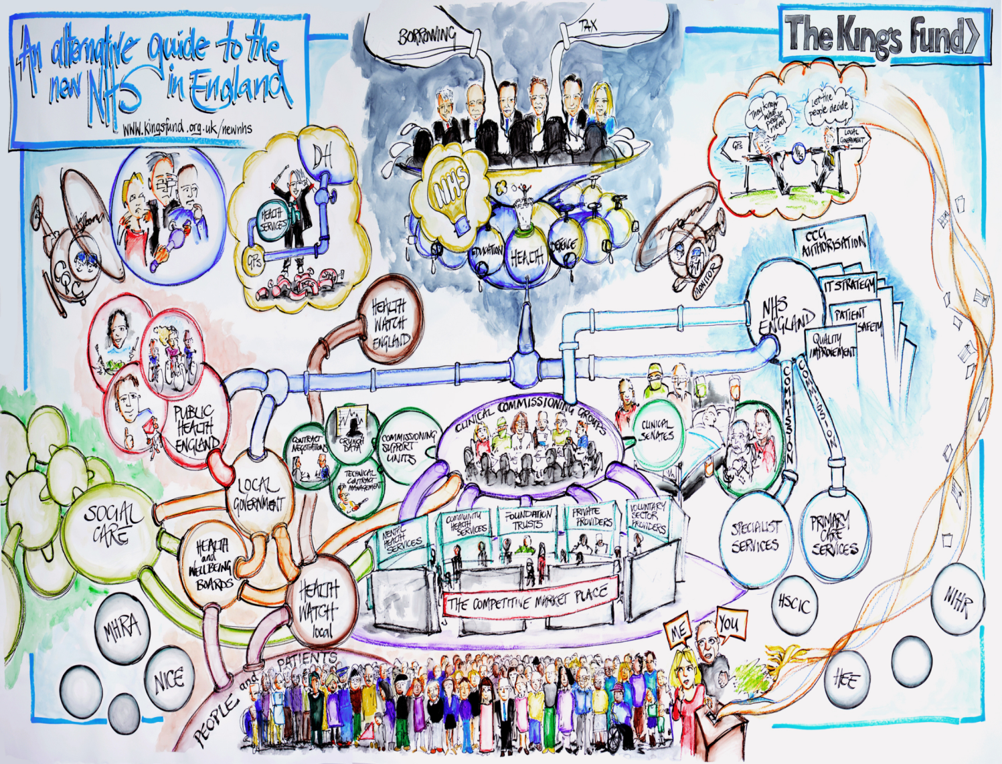

Slide 3


People at the Centre of our Business
“Neil inspired confidence in Mum, through professional knowledge and his unquestionable commitment to her well-being…he saw how much mum wanted to live and how content she was, because he saw her in her own home”
“The team made me feel as "me" and not as someone else, or a group of people”
“polite, well-dressed and always treated my husband and me with compassion, respect and dignity”.

Slide 4
Who are we?
Social Enterprise
Community Interest Company

Slide 5

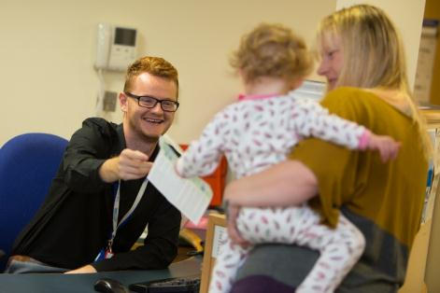
A very different approach to community healthcare…
We are a different type of healthcare provider, free from the constraints of the NHS yet distinct from typical private sector providers.
We’ve been operating as Plymouth Community Healthcare since 2011 having set up as a Community Interest Company (CIC) through the Department of Health’s Transforming Community Services programme
In contrast to others, we work to a social bottom line – driven by a social mission, any surplus we generate we reinvest in the quality of our services or directly into community projects
We are very proud of our background, and offer both real-world pragmatism alongside that vital care experience, coupled with our agile approach to continuous improvement and innovation that now sits at the heart of our organisation
Notes:
5

Slide 6


Slide 7


Slide 8


Slide 9
Plymouth Community Healthcare CIC
Annual turnover of approximately £100 million
Employs approximately 2,800 people

Slide 10

… our collaborative approach to integrated care…
172 Plymouth Council adult social care staff TUPE to PCH in April 2015
PCH is a single integrated health and social care provider to the city of Plymouth
Notes:
10

Slide 11
















Slide 12
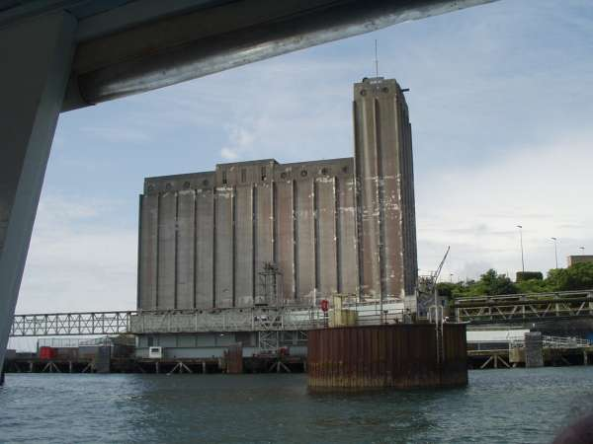

Slide 13


Slide 14

Growing Staff Engagement
Launched 1 April as ‘Our Voice’ Employee Engagement Forum
Empowerment and engagement
Time, Support, Delivery
Models of service delivery based on staff engagement and development
Crisis Response Team development

Slide 15

Individualised and carers at the centre
Personalised and localised models
Care which reflects personal needs
Community and Voluntary Sector – Grants and other arrangements
Clear understanding of needs
Clear understanding of resources
Devonport

Slide 16
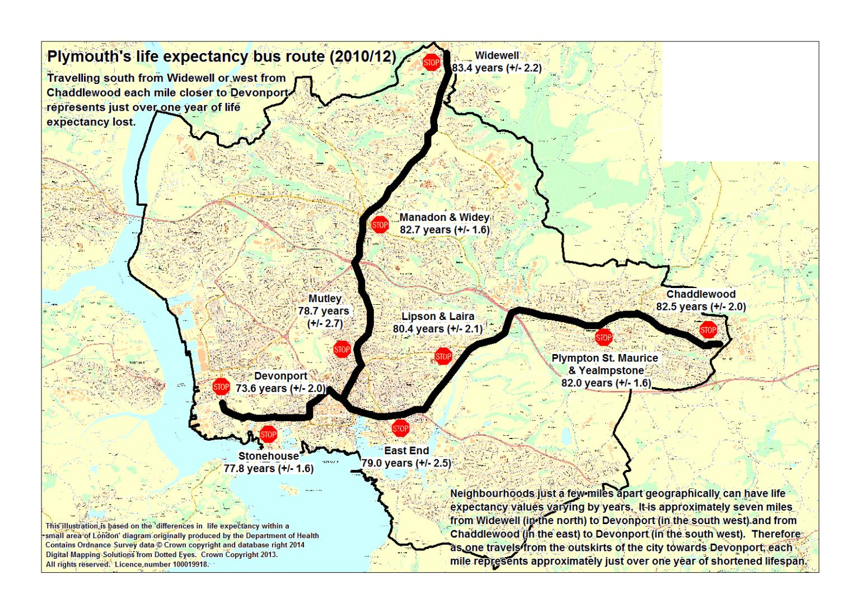

Slide 17
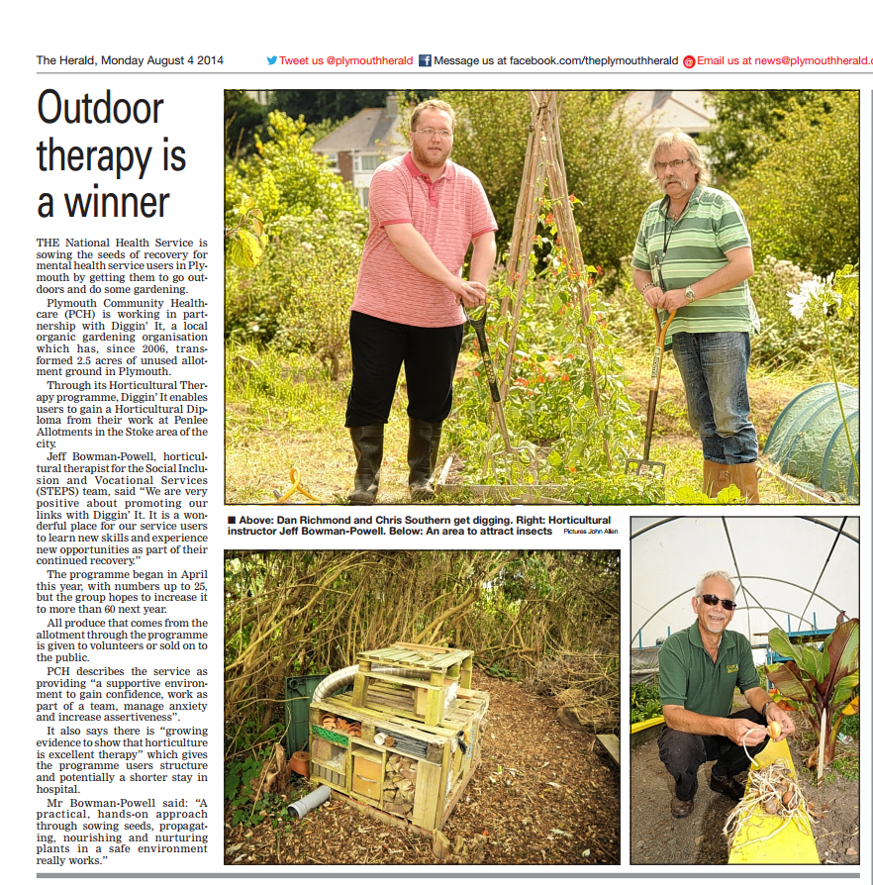
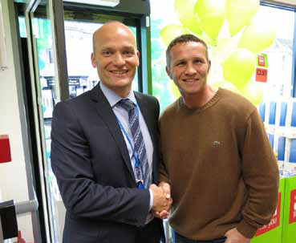

Slide 18

Consistent outcomes
Honest and open relationships
Involvement and working with Commissioners
PEOPLE
Receiving services
Delivering Services

Slide 19

Provide clinical leadership in our community
Integrated and seamless delivery
CAUTI
Pressure Ulcers
Community Crisis Response Team
Robin…

Slide 20
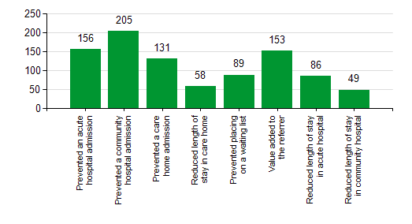
Community Crisis Response Team

Slide 21
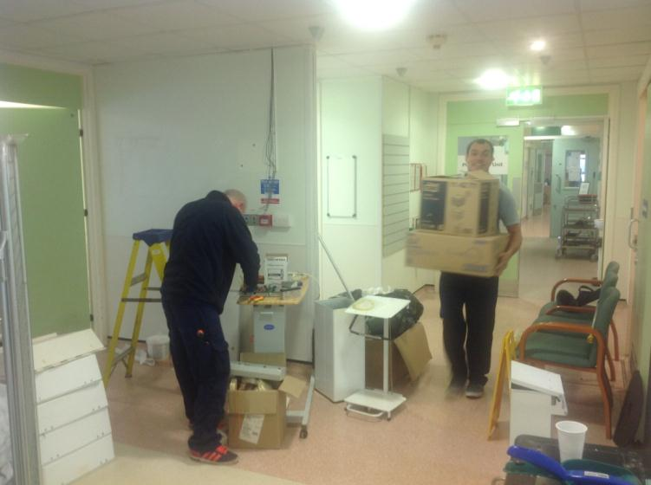
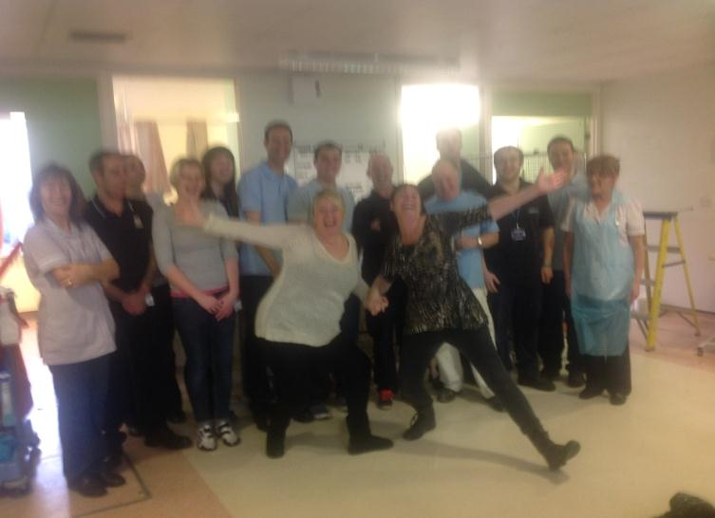
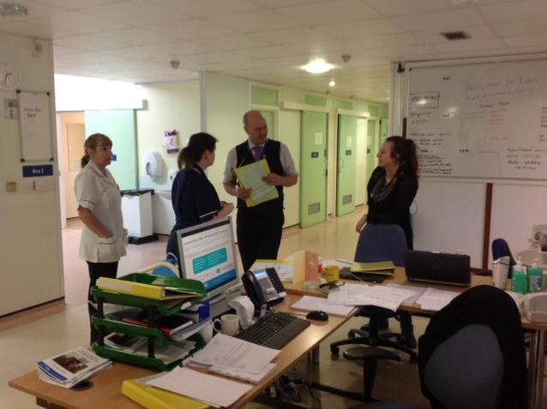
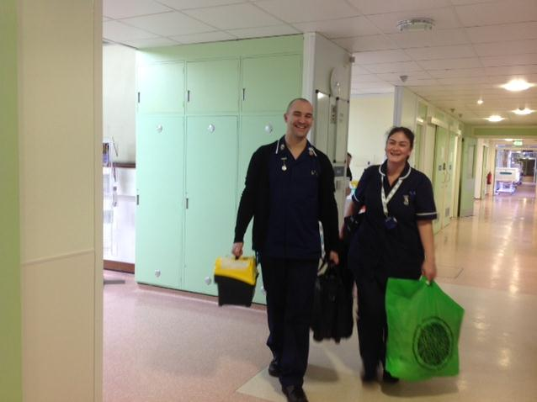
“UNBRIDLED POSITIVITY”
The Art of the Possible

Slide 22

Financial Framework
Service Delivery Models
Commissioning arrangements
Commissioning Partnerships
Staffing and different approaches
Apprentices
Schools
Paid Work Placements
Student placements – all professions
Shortened courses – Social Care
Scholarships – RGNs, RMNS
Assistant Practitioners
Universities, HEE, Colleges
Information – Clinical AND Care Systems – one source

Slide 23

Onwards….

Slide 24
• `
Questions?
Our website: www.plymouthcommunityhealthcare.co.uk
Twitter: @PlymouthHealth
Facebook: www.facebook.com/plymouthcommunityhealth
Notes:
24

