Slide 1
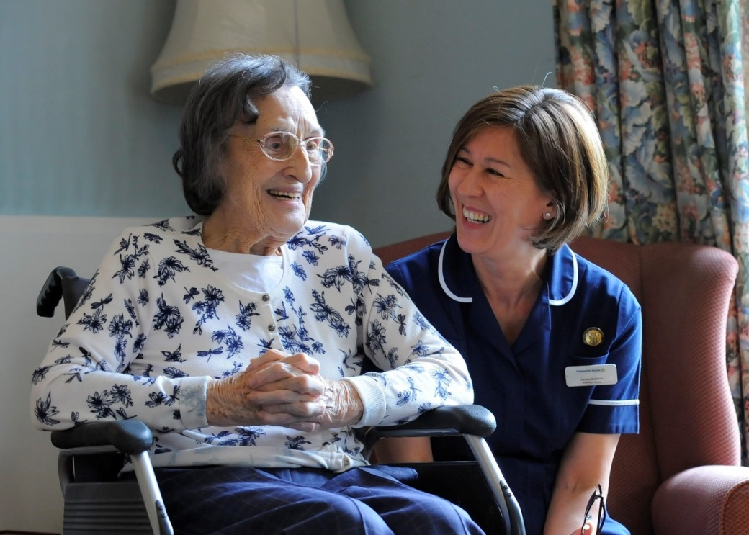
Care Quality Commission
‘What good looks like’
Robert Sobotka – Inspection Manager ASC
8 June 2016
1
Notes:
1

Slide 2
CQC purpose and role
Our purpose
We make sure health and social care services provide people with safe, effective, compassionate, high-quality care and we encourage care services to improve
Our role
We monitor, inspect and regulate services to make sure they meet fundamental standards of quality and safety and we publish what we find, including performance ratings to help people choose care

Slide 3
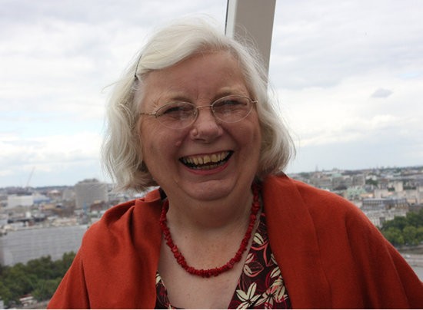
Ambition for social care: The Mum Test (or Anyone You Love test)
Is it responsive to people’s needs?
Is it good enough for my Mum?
Is it
effective?
Is it safe?
Is it
well-led?
Is it caring?

Slide 4
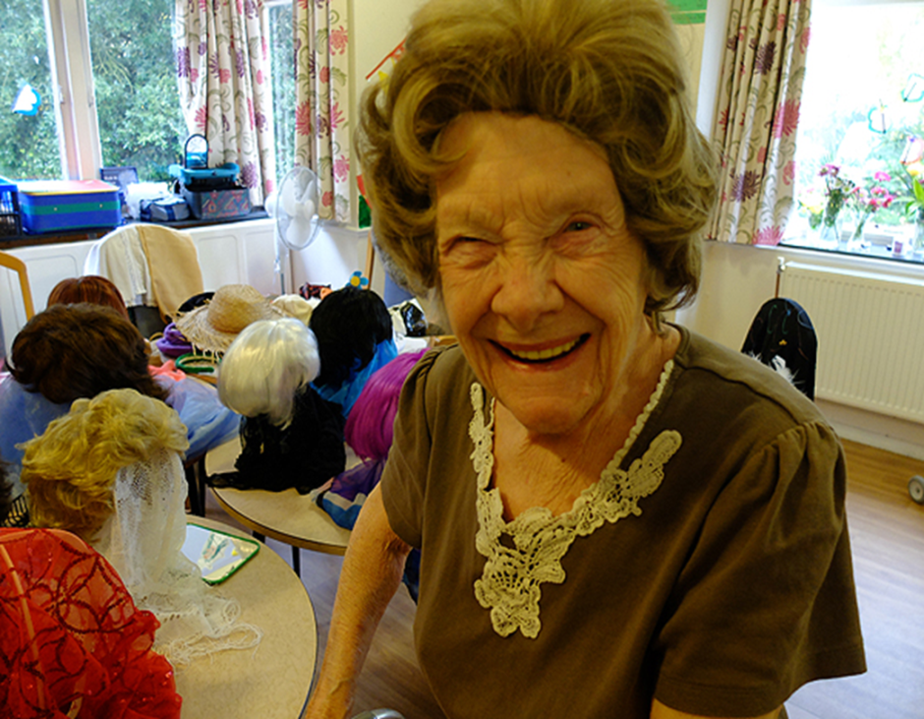
Regulation to inspire improvement
What we do:
Set clear expectations
Monitor and inspect
Publish and rate
Celebrate success
Tackle failure
Signpost help
Influence debate
Work in partnership

Slide 5
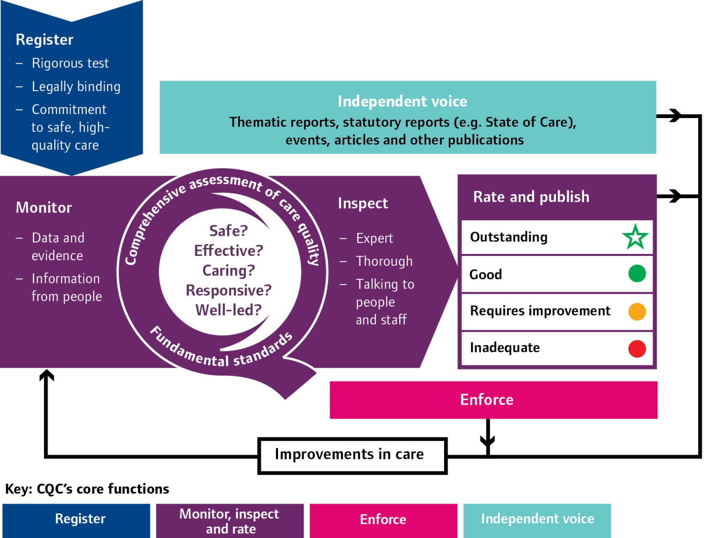
Our new approach
Notes:
Our new operating model describes how we will register, monitor, inspect and award ratings to providers.
The new regulations on fundamental standards means that all registered providers must demonstrate that they are meeting regulatory requirements in order to register with CQC and then continue to deliver regulated services.
The new regulations will strengthen our approach to assessing applications for registration with CQC and the registration process.
In comprehensive inspections (which lead to ratings of individual services and of the provider overall), we primarily look for good care, rather than checking compliance with regulations.
However we will consider whether a regulation has been breached. We will take this guidance into account to determine whether a provider is meeting the new regulations. This then leads to what enforcement action we will take to address breaches of regulations.

Slide 6
Delivering on priorities (1)
New directorates create
April 2014
Wave inspections
***
Co-production groups/ task and finish groups/ roundtable groups
***
Public steering groups/focus groups
***
Provider and public online communities
Provider handbook consultations
A New Start
June 2013
Signposting documents
6

Slide 7
Delivering on priorities (2)
KLOES and Ratings published
New approach inspections rolled out
New regulations including Fit and Proper Person and
Duty of Candour
introduced
April 2015
All services rated
State of Care
October 2014
7

Slide 8
Fit and proper person requirement
Purpose
Ensure directors or equivalents are held accountable for the delivery of care and
They are fit and proper to carry out this role
Actions for providers
Ensure recruitment of ‘directors’ tests whether candidates meet the requirement
CQC
Registration
Respond to concerns raised
Notes:
Providers must take proper steps to ensure that their directors (both executive and non-executive) are fit and proper for the role.
Directors must be of good character, physically and mentally fit, have the necessary qualifications, skills and experience for the role, and be able to supply certain information (including a Disclosure and Barring Service check and a full employment history). Those who are unfit will include individuals on the children’s barred list or the adults’ barred list. They must not be prevented from holding a director’s post under other laws like the Companies Act or Charities Act.

Slide 9
Special measures
Purpose
Ensure failing services improve or close
Actions for providers
Use time available to improve service
CQC
Services rated as inadequate will go into special measures
Time limited period to improve
Improvements made – out of special measures
No improvement – move to cancel registration

Slide 10
Scores on the doors
Purpose
Public able to see rating of service quickly and easily
Actions for providers
Display ratings in service and website
Suggest accompany with additional information
CQC
Will provide template
Inspection – check that rating is displayed

Slide 11
What will market oversight do?
Purpose
Protect people in vulnerable circumstances by spotting if a provider may fail – and make sure right action is taken
CQC will:
Monitor finances of ‘difficult to replace’ providers – 40-50
Provide early warning to local authorities
Assist with system response if failure occurs
It will not:
Either ‘bail out’ struggling providers, or pre-empt failure through inappropriate disclosure of information
6

Slide 12
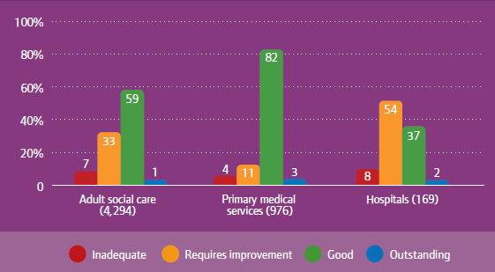
A challenging environment
Despite challenging circumstances, the majority of services
have been rated as good, with some rated outstanding
3
Notes:
The health and care system in England has come under increasing pressure during 2014/15, driven by changing care needs and financial demands
Providers and staff are being asked to deliver significant efficiency savings
Many services have responded well - managed to improve or maintain quality
The environment will become even more challenging - the effective use of resources will be a vital component of success
But some people get care that is not acceptable
Seven per cent of services are inadequate
The level of variation in quality that we see is also of great concern

Slide 13
Safety
There is significant variation in quality - and safety continues to be the biggest concern
4
Notes:
Safety is a fundamental expectation for people, but it is our biggest concern
Our inspections over 2014/15 found that:
13% of hospitals are inadequate
10% of adult social care inadequate
6% of primary medical services inadequate
Safety is affected by a failure to investigate incidents properly and learn from them, ineffective safety and risk management systems and inadequacy of staffing numbers and mix, alongside skills, training and support

Slide 14
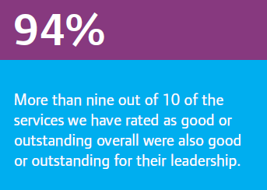
Leadership
Strong leadership is emerging as more crucial than ever to delivering good care
Effective planning
Focus on delivering for people
Culture of openness and staff engagement
Willingness to collaborate with partners
5
Notes:
94% of services rated good or outstanding overall were also good or outstanding for leadership
84% of services rated as inadequate overall were inadequately led
Importance of leaders who are visible, engage widely with people who use services and staff, promote a strong culture of safety, put in place robust governance systems and plan their resources well
Having the right number and mix of staff, with the right skills, at all times is integral to providing safe, high-quality care

Slide 15
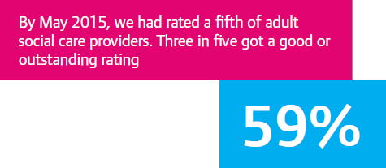
Adult social care
A registered manager consistently
in post has a crucial influence on quality
Staff recruitment and retention remain a serious challenge
7
Notes:
Sector under pressure - issues around the sustainability of provision due to cuts to LA budgets, increasing costs and high vacancy rates
Despite this, inspections showed that almost 60% of services were providing good or outstanding care
However, 7% of services were rated inadequate: safety being the biggest concern
Contributory factors were staffing levels, understanding and reporting safeguarding concerns, and poor medicines management
Having a consistent registered manager in post has a positive influence- outstanding leaders demonstrate passion, excellence and integrity, collaborate with staff and the provider, and ensure people’s views and wishes are at the centre of their care

Slide 16
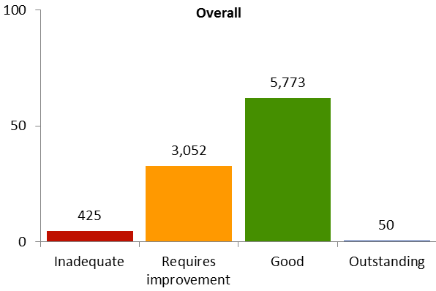
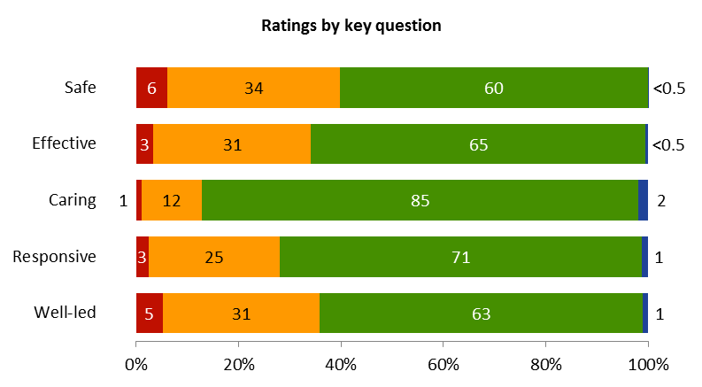
Current ratings overall and by key question
Current overall ratings
Inadequate | Requires improvement | Good | Outstanding
5% | 33% | 62% | 1%
Source: Ratings data extracted 26/11/2015

Slide 17
Common themes from ‘well-led’: Outstanding
Effective monitoring, quality assurance and audit
Open culture - people can share views and issues are addressed
Services have a consistent registered manager supportive of staff
People speak highly of the service
CQC Published reports – sampled for data on well-led. Sample size 177, 50 services with outstanding ratings (all outstanding ratings for well-led when the sample was extracted) for and 127 for services with inadequate ratings for well-led.

Slide 18
Common themes from ‘well-led’: Outstanding
Effective systems to manage and develop staff
Safe care promoted – good oversight of care and staff communication
A can do, will do, attitude
Effective partnership working
Continuous development of the service/manager/staff with best practice followed
Service/staff recognised through awards
Strong links with local community
“This place is brilliant, management care so much, as do the staff, everybody knows their role and the atmosphere is amazing.”, “I’m made to feel important, I’m constantly encouraged to always better myself.”
CQC Published reports – sampled for data on well-led. Sample size 177, 50 services with outstanding ratings (all outstanding ratings for well-led when the sample was extracted) for and 127 for services with inadequate ratings for well-led.

Slide 19
Common themes from ‘well-led’: Inadequate
People speak of management churn and change
Poor care planning = lack of personalised care
Closed culture - people cannot raise issues or views are not listened to or acted upon
Registered manager unable to lead and support staff well, or not in post
Poor care oversight with care plans not up to date, reviewed or followed
CQC Published.

Slide 20
Common themes from ‘well-led’: Inadequate
Ineffective systems to identify and manage risks and learn from mistakes
Lack of supervision and training opportunities to develop staff skills
Poor working relationship between the manager and the provider
Under developed partnership working and community links
Unawareness of best practice
Notifications to CQC not made
CQC Published reports – sampled for data on well-led. Sample size 177, 50 services with outstanding ratings (all outstanding ratings for well-led when the sample was extracted) for and 127 for services with inadequate ratings for well-led.

Slide 21
The future for CQC
Focusing on quality
Providing better information
Encouraging innovation
Becoming a more efficient regulator
Working with partners to encourage improvement
Our new strategy for 2016-2021 will help us to achieve these goals
13
Notes:
CQC has an important role in working with national and local partners to support sectors and providers in building resilience to maintain their focus on quality
We have started to promote transparency - conversations about quality are becoming more open and honest across all stakeholders
We are developing a new strategy for 2016-21 in consultation and co-production with our stakeholders
We are keen that our approach leaves room for providers to innovate and develop how they provide care, as long as it remains safe and of good quality
The new strategy will focus on being more efficient by considering the right balance between registration, inspection, monitoring and information from providers; and building stronger relationships with our partners to encourage improvements for people who use services

Slide 22
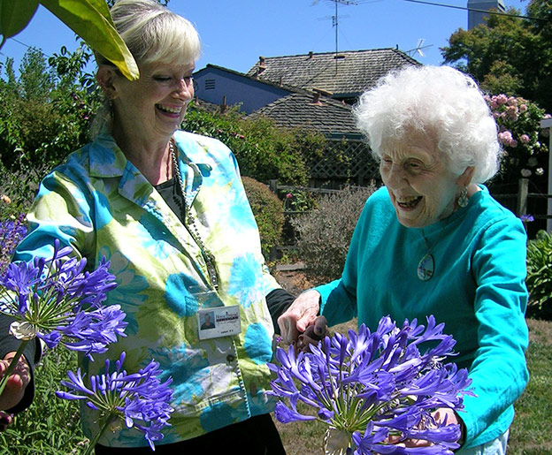
Outstanding care at home
‘Staff were given the opportunity to build meaningful relationships with people and ample time to meet people’s needs and provide companionship’
Home Instead Senior Care,
West Lancashire and Chorley
‘People felt care workers treated them with kindness and respect’
‘The registered manager delivered dementia training to the public – including bank and shop staff – to help them understand how to help people with dementia’

Slide 23
An outstanding care home
"We didn't think we were outstanding. And perhaps that's why we were – I think it's because we see every single person as an individual. It is our privilege to support them to live the last years of
their life with as much happiness, love and security as we can give them."
Suzanne, Prince of Wales House, Ipswich

Slide 24
What should we do?
Stand up for adult social care
Celebrate the good
Challenge the bad
Be positive and honest
Work together
And…always remember why we do this
9
Notes:
Stand up for adult social care. The public is so much more aware of what adult social care is, why it’s important, who pays for it, whether or not it is high quality. There is more awareness, higher expectations and much criticism. Stand up for social care, be proud of what’s good, be positive and fight for it to be better.
I know that finances are increasingly squeezed, but commissioners should celebrate the good and commission for quality, not just price. Like I said, good care has the power to change people’s lives. Be positive and honest, and work together.
Use our information to change lives. Use our information to take action, to argue for more resources, to encourage choice, to encourage providers to raise standards. Use the findings in State of Care, in Cracks in the Pathway and on our website (all these can be found on our exhibition stand).
Celebrate the good, challenge the bad.
And …. as you lead services from the top, remember why we – and all our colleagues and staff – do this.
With thanks to Community Care – these images can be found on their stand in their 2015 charity calendar.

Slide 25
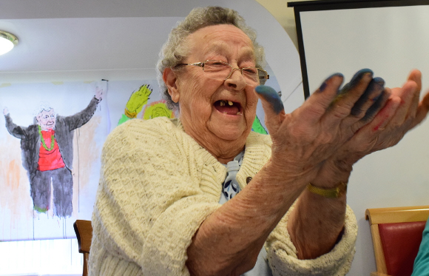
Remember why we do this……
Copyright: Community Care

Slide 26
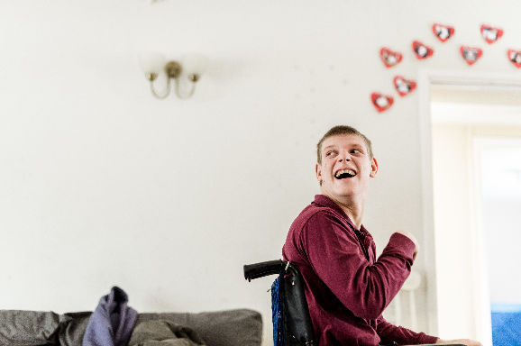
Remember why we do this……
Copyright: Community Care

Slide 27
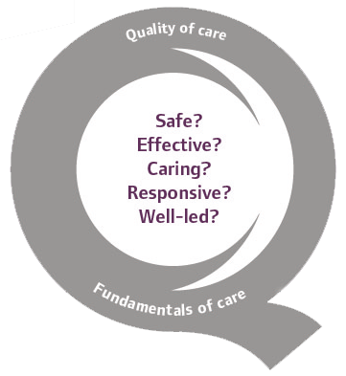
Thank you
www.cqc.org.uk
enquiries@cqc.org.uk
@CareQualityComm
Robert Sobotka
Inspection Manager

