Slide 1
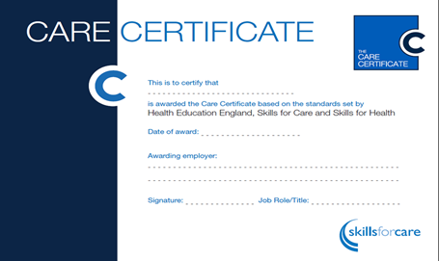
The Care Certificate
“we help to improve social care standards”

Slide 3
Care Certificate principles
Equips people with the skills and knowledge to provide quality care

Slide 4
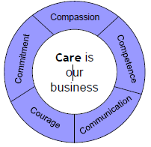
The Care Certificate is:

Slide 5
Standards …
Fluids and nutrition
Awareness of mental health, dementia and learning disability
Safeguarding adults

Slide 6
Standards continued…
Safeguarding children
Basic life support

Slide 7
Assessment must be:
Skills assessed primarily within the care setting unless simulation allowed
with people who use services
completed face to face by an occupationally competent assessor

Slide 8
What do other employers say
Dawn James Best employer of over 250 staff –
The Skills for Care Accolades 2013/14 Cornwall Care Limited
More importantly, we’re also looking for people with approachability who can motivate workers. Assessing isn’t just about someone’s practices – it’s about being able to educate and motivate at the same time. What I’m always looking for is someone who can correct poor practice or extend good practice in a way that isn’t belittling to the learner. It’s important that an assessor is able to deliver feedback in a very constructive and motivating way.”

Slide 9
Skills for Care have developed a number of resources to support you with the implementation

Slide 10
Handling information
The information about an individual's care and support may be personal and sensitive. This information must be treated as confidential and only shared with people who need to know.
Respecting confidentiality is:
A legal requirement
Essential to promote the individual
An important part of building trust.

Slide 11
Challenges
Assessment
Supervision – ‘line of sight’
Particular concerns form live in care and domiciliary care providers

Slide 12
Care Certificate Product Range
The Care Certificate
Standards
The Care Certificate Framework
Assessors Document
The Care Certificate Framework
Guidance Document
The Care Certificate Mapping
The Care Certificate
Certificate
The Care Certificate
FAQs
Self Assessment tool
The Care Certificate
workbook
The Care Certificate
Presentations

Slide 13
How to find out more…
Visit our website www.skillsforcare.org.uk/carecertificate
For regular updates sign up to our enews: marketing@skillsforcare.org.uk

