Slide 1
Right to Work in the UK
Make a note of this website:-
www.gov.uk/check-job-applicant-right-to-work

Slide 2
Right to Work in the UK
You must see the applicant’s original documents.
You must check that the documents are valid with the applicant present.
You must make and keep copies of the documents and record the date you made the check.

Slide 3
Right to Work in the UK
Avoiding discrimination while preventing illegal working: a code of practice is available online
“You must not discriminate against anyone because of their race.”
Code of practice for employers: avoiding unlawful discrimination while preventing illegal working
https://www.gov.uk/government/publications/right-to-work-checks-code-of-practice-on-avoiding-discrimination

Slide 4
Right to Work in the UK
An employer’s guide to right to work checks
This document is available online at
https://www.gov.uk/government/publications/right-to-work-checks-employers-guide

Slide 5
Right to Work in the UK
An employer’s guide to acceptable right to work documents
This document is available at
https://www.gov.uk/government/uploads/system/uploads/attachment_data/file/441957/employers_guide_to_acceptable_right_to_work_documents_v5.pdf
It contains examples of documents which may be submitted in support of an application for employment (e.g. sample Passports, UK Residence permits, Asylum Registration Cards)
And also some useful links to websites which assist with forgery detection

Slide 6
Penalties for employing illegal workers
Illegal workers include:
students with expired visas, or students working more hours than they’re allowed to
people who work on a visitor’s visa
If you’re caught employing an illegal worker
You’ll get a ‘referral notice’ to let you know that:-
your case is being considered
you may get a fine (also known as a civil penalty) of up to £20,000 for each illegal worker.

Slide 7
Checking the documents
the documents are genuine, original and unchanged and belong to the person who has given them to you
the dates for the applicant’s right to work in the UK haven’t expired
photos are the same across all documents and look like the applicant
dates of birth are the same across all documents
the applicant has permission to do the type of work you’re offering (including any limit on the number of hours)
for students you see evidence of their study and vacation times
if 2 documents give different names, the applicant has supporting documents showing why they’re different, eg a marriage certificate or divorce decree

Slide 8
Taking a copy of the documents
make a copy that can’t be changed, eg a photocopy
for passports, copy any page with the expiry date and applicant’s details (eg nationality, date of birth and photograph) including endorsements, eg a work visa
for biometric residence permits and residence cards (biometric format), copy both sides
for all other documents you must make a complete copy
keep copies during the applicant’s employment and for 2 years after they stop working for you
record the date the check was made
Data Protection law applies

Slide 9
If the job applicant can’t show their documents
You must ask the Home Office to check your employee or potential employee’s immigration employment status if one of the following applies:
you’re reasonably satisfied that they can’t show you their documents because of an outstanding appeal, administrative review or application with the Home Office
they have an Application Registration Card
they have a Certificate of Application for an EEA permit that is less than 6 months old

Slide 10
If the job applicant can’t show their documents
Application Registration Cards and certificates of application must state that the work the employer is offering is permitted. Many of these documents don’t allow the person to work.
The Home Office will send you a ‘Positive Verification Notice’ to confirm that the applicant has the right to work. You must keep this document.

Slide 11
Helpline
You won’t have to pay a civil penalty if you can show you made the correct ‘right to work’ checks.
Sponsorship, Employer and Education helpline Telephone: 0300 123 4699 Monday to Thursday, 9am to 5pm Friday, 9am to 4:30pm

Slide 12
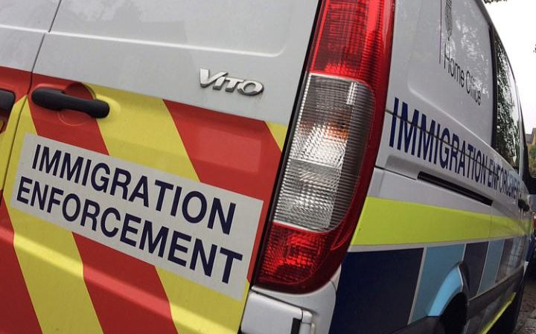
Immigration Enforcement South London ICE Team

Slide 13
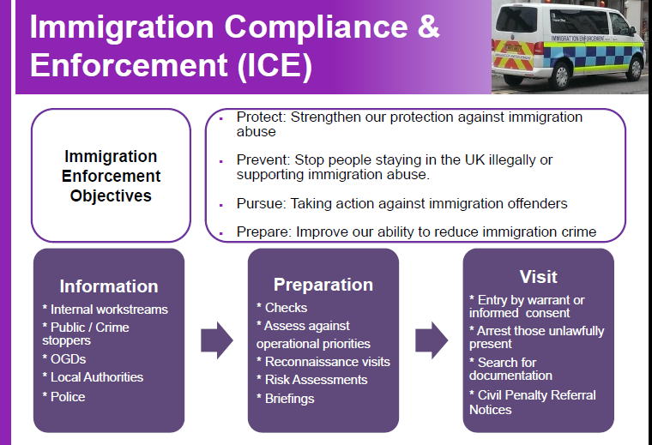
Immigration Enforcement South London ICE Team

Slide 14
Immigration Enforcement South London ICE Team
How to contact us for urgent enquiries affecting South London immigration enforcement matters, or to discuss how best to progress a case:-
SOUTH LONDON ICE TEAM
DUTY OFFICE
020 8196 3470 or 3484
7 days per week

