Slide 2
Communication
www.language-for-caregivers.eu

Slide 3
Communication
Difficult, isn’t it?
When you don’t have the words
www.language-for-caregivers.eu

Slide 4
Communication with…
Peers / co-workers
Hierarchical: Managers and Supervisors
Service users
Relatives and friends
External agencies
www.language-for-caregivers.eu

Slide 5
Migrant workers 2016
In Bavaria, migrant workers account for 60-80% of staff in residential care facilities
At a recent conference in Bavaria it was suggested that:
‘If this is where Germany are now, it’s only a matter of time before the UK reaches the same figures’
www.language-for-caregivers.eu

Slide 6
TLC Pack
A language learning resource
Based on care giving scenarios
Designed to develop vocationally specific language
Available online and offline
www.language-for-caregivers.eu

Slide 7
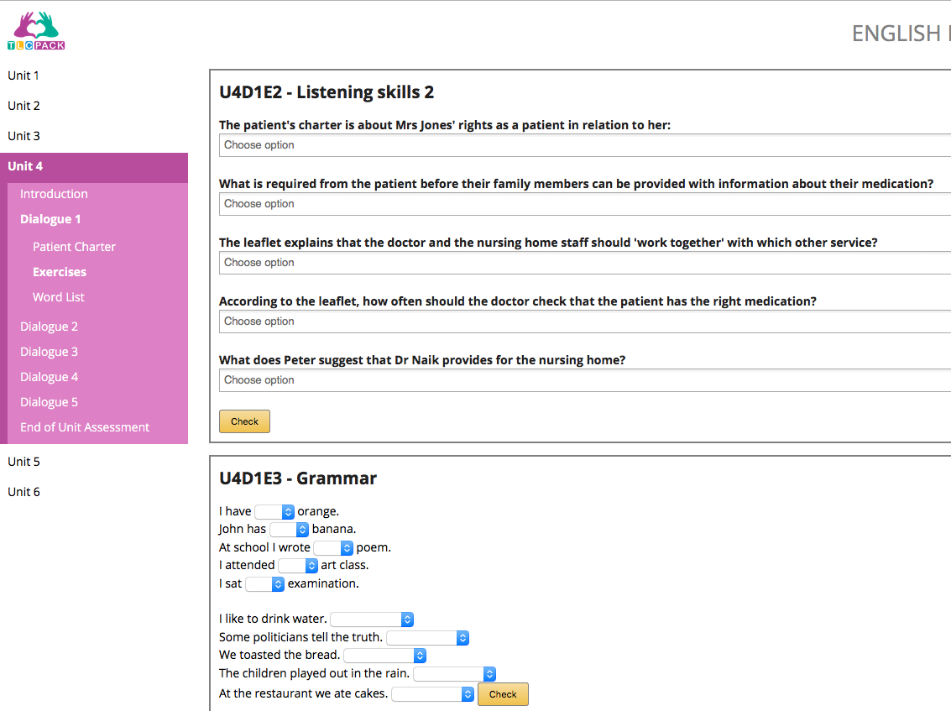
TLC Pack
Can be used in any context…and adapted to suit needs
Supports formal language courses, self-study, training courses and ad-hoc use
Developed via funding from the European Commission
www.language-for-caregivers.eu

Slide 8
TLC Pack
It’s completely FREE to use
No sign-up, no log in, just access the web page and either download resources or use the online version
www.language-for-caregivers.eu

Slide 9
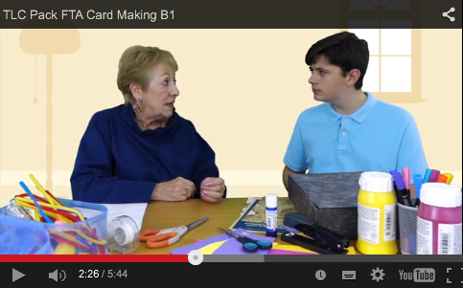
Topics include…
Dementia care
Patient charter, pre & post-hospital care
Diet, supplements & exercise
First aid & emergency responses
Care plans & many others
www.language-for-caregivers.eu

Slide 10
Topics include…
In addition to the 30 workplace scenario videos…
There is also an intercultural training package
Resources are available now, with the full package available from June 2016
www.language-for-caregivers.eu

Slide 11
Thank you
www.language-for-caregivers.eu

