Slide 1
Renewable Heat for Care Homes 21st May 2015

Slide 2
Renewable Heat – Looking beyond gas
The benefits of Renewable Heat
Our experience and capabilities
Renewable heat solutions
Biomass heating
Notes:
I am taking this opportunity to briefly show how our experience an expertise can provide cost effective and sustainable renewable heating for your organisation.

Slide 3
Why switch to Renewable Heat?
Notes:
Renewable heating provides a number of benefits, including
Savings of up to 40% on your existing fuel costs
A substantial contribution to the sustainability and corporate social responsibilities or obligations of your organisation.
- Positive PR – be known for being green, investing in the future and enhance your positive profile with your stakeholders
- Deliver a payback on investment through the Renewable Heat Incentive (RHI). Get paid for generating heat with a guaranteed income for 20 years, index linked to the retail price index , paid from the treasury budget. Depending on use and size some very attractive simple paybacks can be achieved.
-Cushion against fluctuations in fossil fuel prices by introducing diversity into the ways you heat your properties–fixed fuel or heat supply contracts are available to help you better plan financially for the future
- Contribute to the local economy – some solutions use locally supplied wood fuel

Slide 4
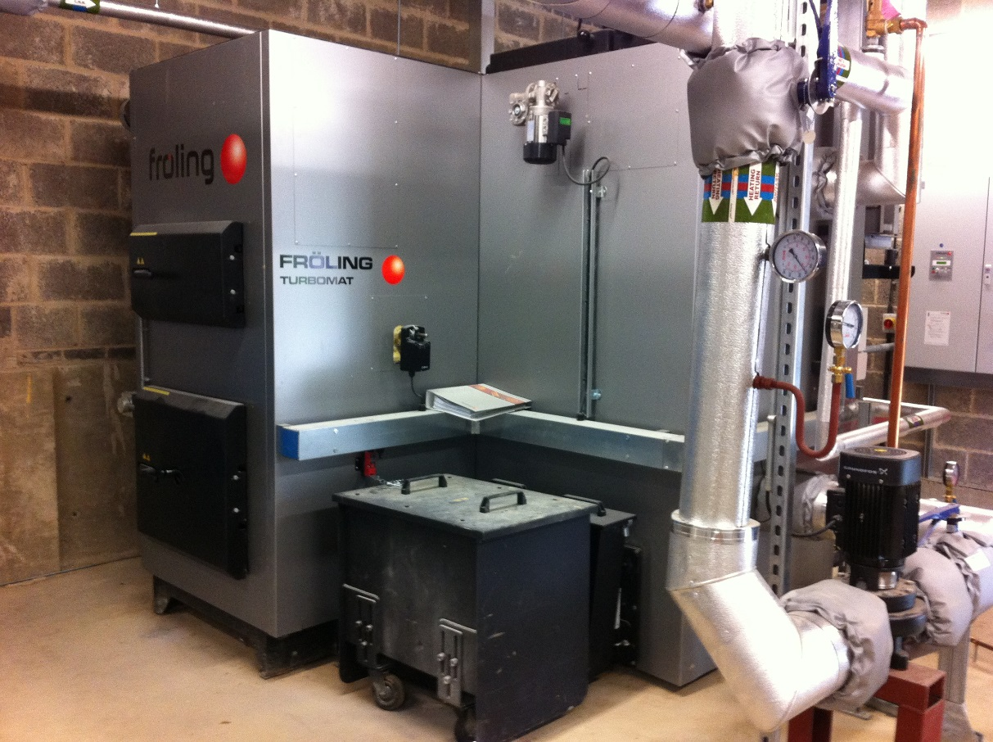
Our experience and capability
Notes:
- British Gas is known as an organisation to trust . As always with British gas, the Customer is at the heart of any project decision, if its not right for the customer its not right for Us. We have a reputation we need to protect and will not leave site until everything installed is working correctly
- Our team specialises in modern, RHI eligible and low carbon heating technologies including – biomass boiler systems , heat pump installations , communal systems and heat distribution networks.
- British gas has over 16 years experience of installing renewable heating to businesses and the public sector with more than 750 commercial scale systems installed.
- We are a ROSPA Gold Award winner and have numerous Health and Safety accreditations including Chas, Constructionline, Safecontractor and Considerate Contractor – ensuring the safety of our staff and protecting the welfare residents, staff and visitors .
- We have extensive Design and Project Management expertise
- British Gas also offer Ongoing service and maintenance support tailored to your needs including billing and performance management reporting

Slide 5
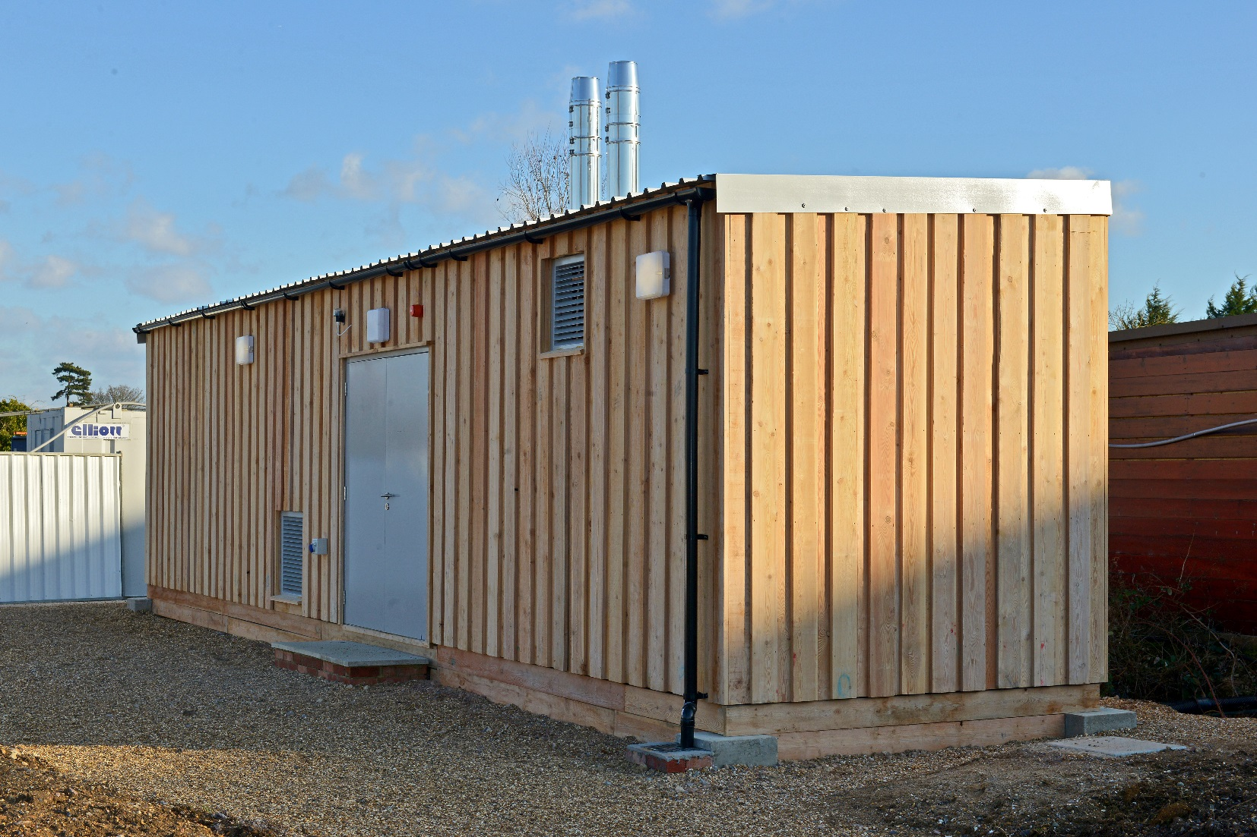
Renewable Heating for existing Care Home
Notes:
Changing the way you generate heat doesn’t have to be complicated or, most importantly, disrupt the excellent service that you provide.
I will briefly focus on biomass, as this renewable heat solution is particular suitable for retrofit into an existing care home or similar building with a large heat use.
A Biomass boiler is a direct replacement for fossil fuel boilers. Wood fuel is burnt in a boiler, to provide heating or hot water through the existing distribution system
Biomass is a mature proven technology which is highly efficient, fully automatic and has low emissions.

Slide 6
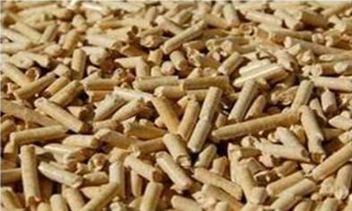
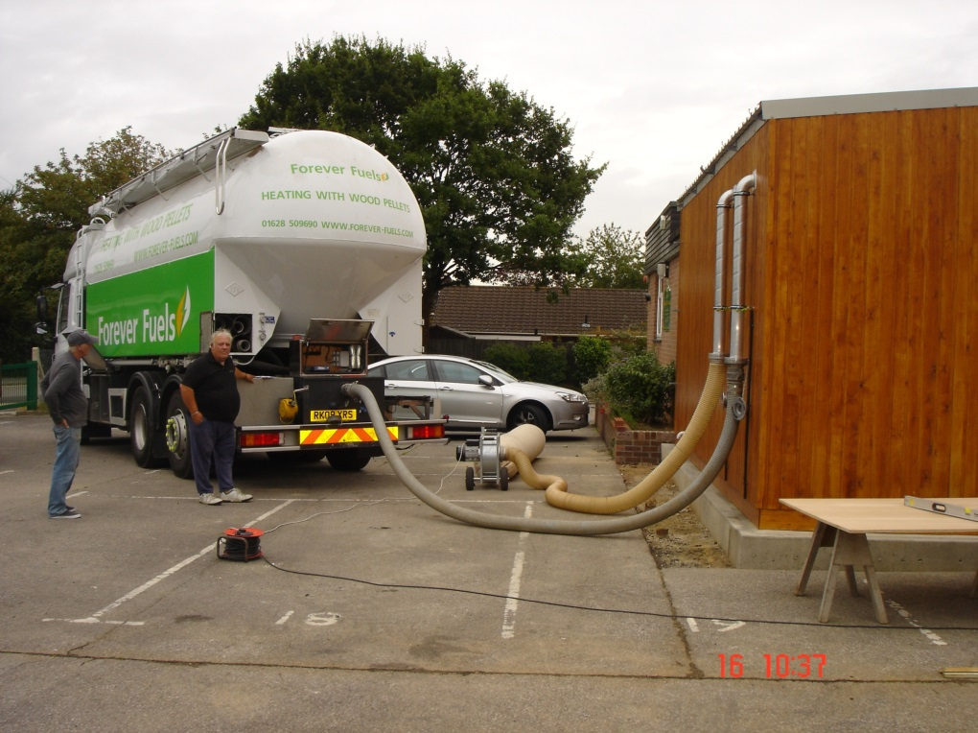
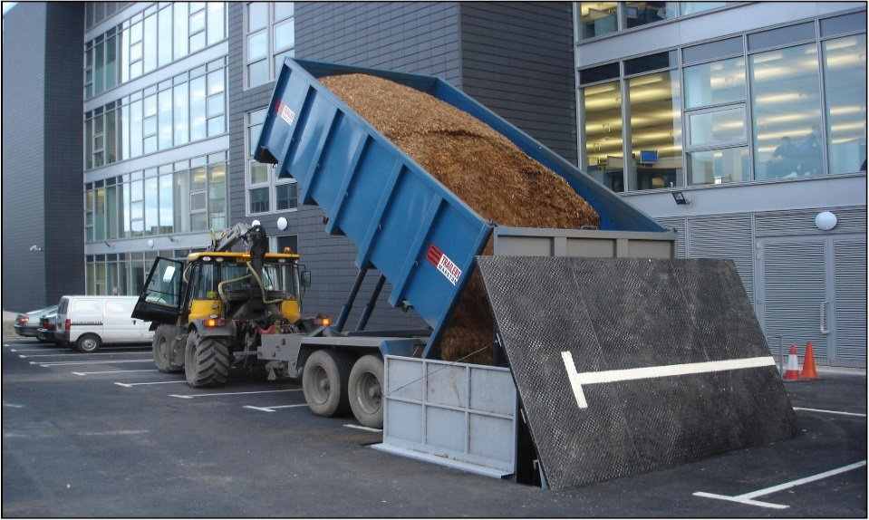
Biomass fuel options
Notes:
The biomass solutions that British Gas offer use either wood chip or wood pellets
There are price versus space and convenience considerations that need to be decided in the early stages of planning a project.
Pellet has a high energy content and as it can be sucked or blown, is easier to take deliveries from a tanker up to 20 metres from the store via hoses . As wood pellets are a manufactured product, they are more expensive than chip and cost a similar amount to gas .
Woodchip is harder to move about – the best solution is to have a fuel store underground , allowing for chipped to be tipped in from a truck for a quick delivery . Wood chip is cheaper than pellet and better suited to rural areas .
However, Biomass may not be the best solution for your Care Home.
British Gas are the experts and will guide you through finding the best solution .Please come and talk to me later about your own heating requirements.

Slide 7
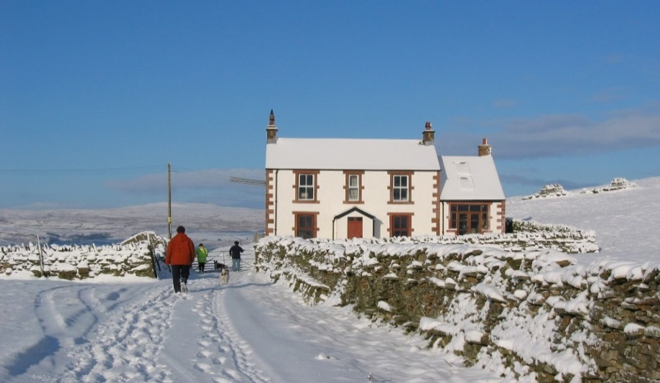
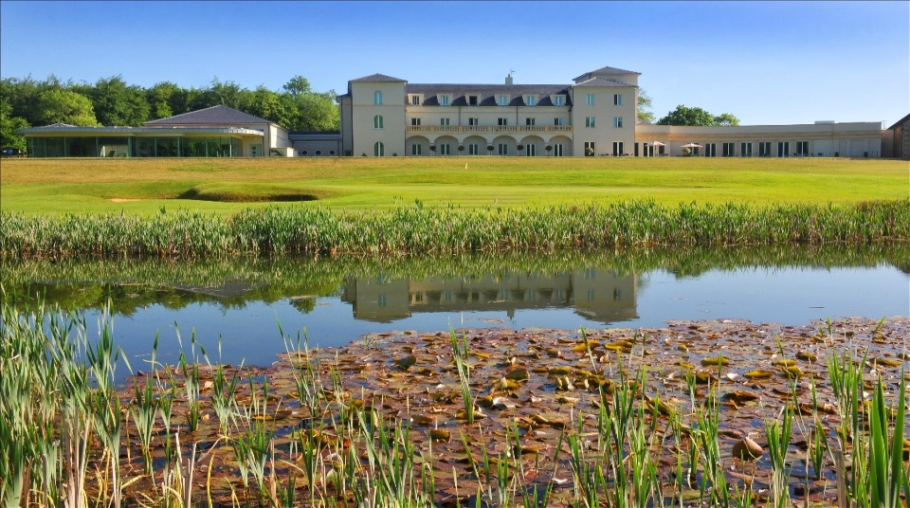
Biomass solutions for every customer
Notes:
Some quick example biomass projects , clockwise from top left
a domestic 5 bed, detached house, not on the gas grid and originally using heating oil . This project was delivered via one of our installer partners
the second pictures shows an ECOBLOX prefabricated energy centre which is constructed off site, and then installed adjacent to the existing energy centre as a ‘plug & play’ solution.
Below this, Bowood main house, which is located rurally. They produce their own wood chip on site. The biomass Boiler provides heating and hot water for a spa, hotel and golf club
Oldham new build energy centre connecting 1,500 homes to a single energy centre with 5MW of biomass and 15MW gas – this was a £5m project.

Slide 8
How we can help you
Notes:
The more heat you use, the better your business case will be .
Offsetting oil or LPG is improves the business case further .
So if you want to reduce your fuel costs and improve the sustainability of your organisation, we will work with you to find the best solution. Please come and find me next to our banner in the lobby.

Slide 9
Thank You British Gas Heat Networks Team Joanna Bould Technical Sales Manager 07702884193 joanna.bould@bghn.co.uk

