Slide 1
Our New Approach
Presenters: Jane Jewell Inspection Manager
&
Steve Rust Inspector
National Care Association
13 August 2015
1
Notes:
1

Slide 2
Our purpose and role
Our purpose
We make sure health and social care services provide people with safe, effective, compassionate, high-quality care and we encourage care services to improve
Our role
We monitor, inspect and regulate services to make sure they meet fundamental standards of quality and safety and we publish what we find, including performance ratings to help people choose care
2
2

Slide 3
The landscape of care
General public
54.5 million (44.5m adults)
Care homes
565,000 residents
165,000 going into care per year
39,000 people with learning disabilities in residential care
18,000 in a care home or care in their own home with no kith or kin
Home-care
700,000 people receiving home-care support per year
Private hospital
1.61 million people receive surgical treatment in a private hospital / year
NHS hospitals
90 million outpatient appointments / year
11 million inpatients / year
18 million A&E attendances
5 million emergency admissions / year
600k maternity users
42,000 detained and treated against their will
Dentists
22 million on a dentist list
15 million NHS
7 million private
GP practices
52 million registered with a GP
150m appointments / year
Health & social care staff
1.7m NHS staff
1.5m in adult social care
Stroke 1m Diabetes 3m Arthritis 8.5m Cancer 2m Dementia 0.7m
↑25% by 2020 ↑67% by 2025 ↑100% by 2030 ↑100% by 2032 ↑100% by 2040
NB There is overlap between our different audiences – none are wholly distinct from the others
Notes:
Slide being updated –
Sources
General public / Adult population: ONS 2015
Private hospital: mid-2013 estimated figure, Laing & Buisson, Private Acute Medical Care 2013 p123

Slide 4
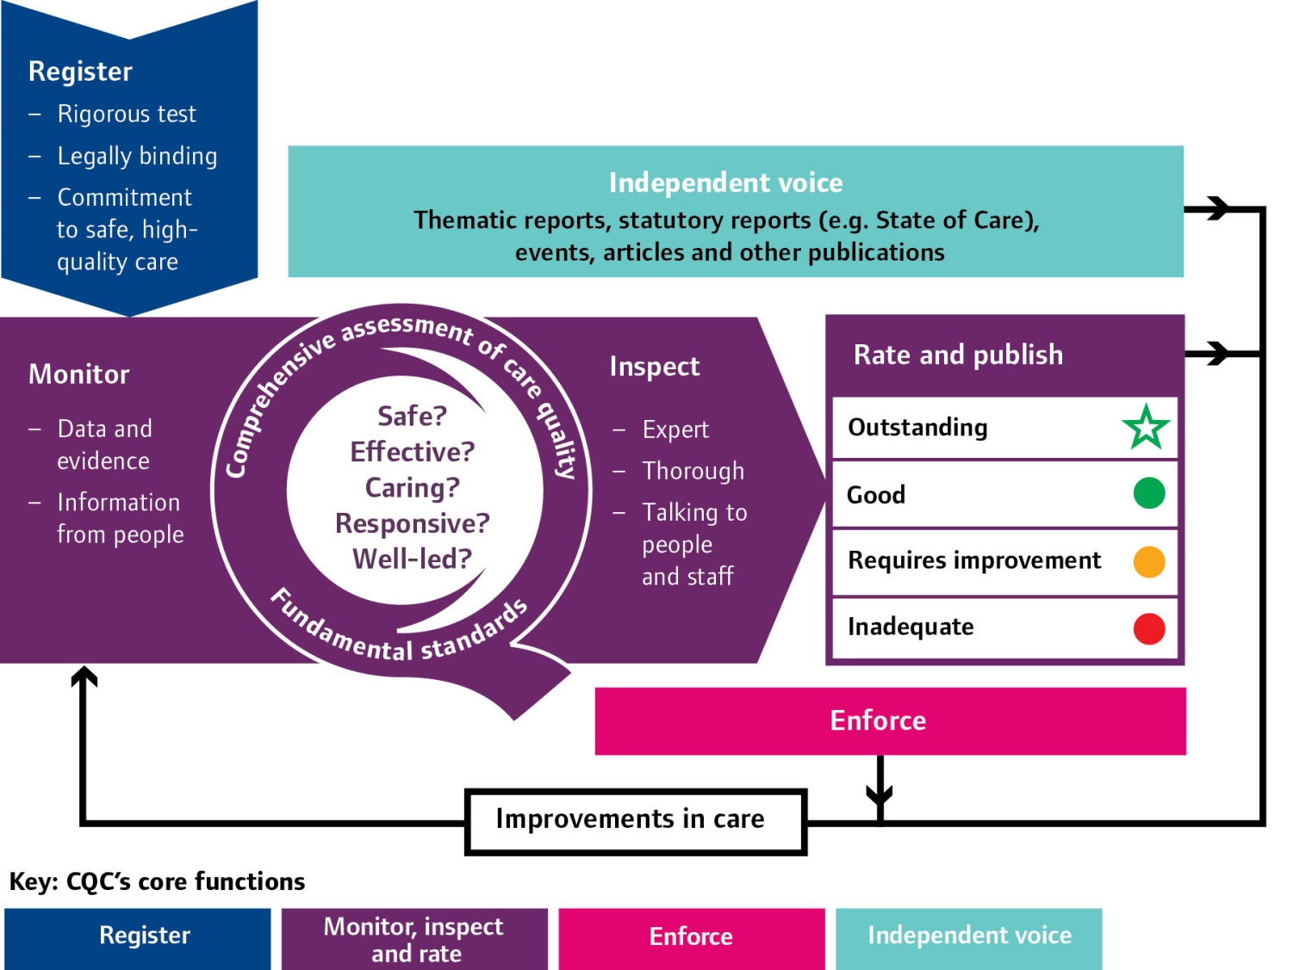
Our new approach
4
Notes:
Not really new any more since October 2015- major consultations
Wave inspection tested out this methodology

Slide 5
Fundamental Standards
Care and welfare of service users
Assessing and monitoring the quality of service provision
Safeguarding service users from abuse
Cleanliness and infection control
Management of medicines
Meeting nutritional needs
Safety and suitability of premises
Safety and suitability of equipment
Respecting and involving service users
Consent to care and treatment
Complaints
Records
Requirements relating to workers
Supporting workers
Cooperating with other providers
Staffing
Previous regulations
New Regulations
Person-centred care
Dignity and respect
Need for consent
Safe care and treatment
Safeguarding service users from abuse
Meeting nutritional needs
Cleanliness, safety and suitability of premises and equipment
Receiving and acting on complaints
Good governance
Staffing
Fit and proper persons employed
and
Fit and proper persons requirement for directors
Duty of candour
5
Notes:
The previous 16 regulations (also known as the ‘essential standards’) have been replaced by 11 regulations that set out the fundamental standards of quality and safety. These regulations are clearer statements of the standards of care below which care should never fall.
There are joined by two new regulations, on fit and proper person requirements for directors and on a statutory duty of candour.
CQC consulted on guidance for providers about fundamental standards and the final provider guidance and enforcement guidance is available on our website.

Slide 6
Asking the right questions about quality and safety
Safe
Effective
Caring
Responsive to people’s needs
Well-led
6
Notes:
We have developed the key lines of enquiry (KLOEs), prompts and sources of evidence sections to help you answer the five key questions
Safe - People are protected from physical, psychological or emotional harm.
Effective - in line with nationally-recognised guidelines. Improving health or independence.
Caring - People are treated with compassion, respect and dignity and that care is tailored to their needs.
Well-led - effective leadership, governance and clinical involvement at all levels. Open, fair and transparent culture. Using people’s views to make improvements.
Responsive to people’s needs - treatment and care at the right time, without undue delay, and that they are listened to in a way that responds to their needs and concerns.

Slide 7
KLOEs – Well-Led
For residential adult social care we ask:
W1 How does the service promote a positive culture that is person-centred, open, inclusive and empowering?
W2 How does the service demonstrate good management and leadership?
W3 How does the service deliver high quality care?
W4 How does the service work in partnership with other agencies?
7
Notes:
Mandatory KLOE only WL 4 would be around working in partnership with other agencies.
That means that the characteristics of ‘good’ for well-led are:
Good
People, their family and friends are regularly involved with the service in a meaningful way,
helping to drive continuous improvement. People’s feedback about the way the service is
led describes it as consistently good.
The service has a clear vision and set of values that include honesty, involvement,
compassion, dignity, independence, respect, equality and safety. These are understood
and consistently put into practice.
The service has a positive culture that is person-centred, open, inclusive and empowering.
It has a well-developed understanding of equality, diversity and human rights and put
these into practice.
Staff have the confidence to question practice and report concerns about the care offered
by colleagues, carers and other professionals. When this happens they are supported and
their concerns are thoroughly investigated.
Staff understand their role, appreciate what is expected of them, are happy in their work,
are motivated and have confidence in the way the service is managed. Managers are
consistent, lead by example and are available to staff for guidance and support. They
provide them with constructive feedback and clear lines of accountability. Support and
resources are available to enable and empower the staff team to develop and to drive
improvement.
The service defines quality from the perspective of the people using it and involves them,
staff and external stakeholders in a consistent way. Quality assurance arrangements are
robust and the need to provide a quality service is fundamental and understood by all staff.
Where required, processes are in place to enable managers to account for actions,
behaviours and the performance of staff.
The service works in partnership with key organisations to support care provision, service
development and joined-up care.
Legal obligations, including conditions of registration from CQC, and those placed on them
by other external organisations are understood and met.

Slide 8
Well-led
Some high level characteristics of Outstanding
The service has a track record of being an excellent role model, actively seeking and acting on the views of others through creative and innovative methods.
There is a strong emphasis on continually striving to improve.
The service finds innovative and creative ways to enable people to be empowered and voice their opinions.
The vision and values are imaginative and person-centred and make sure people are at the heart of the service.
8
Notes:
Here are some exerts of the characteristics of Outstanding for the Well-led domain, taken from the Residential Adult Social Care services provider guidance (p34)

Slide 9
KLOEs – SAFE
For residential adult social care we ask:
S1 How are people protected from bullying, harassment, avoidable harm and abuse that may breach their human rights?
S2 How are risks to individuals and the service managed so that people are protected and their freedom is supported and respected?
S3 How does the service make sure that there are sufficient numbers of suitable staff to keep people safe and meet their needs?
S4 How are people’s medicines managed so that they receive them safely?
9
Notes:
Mandatory areas
S5 is around infection control

Slide 10
Safe
Some high level characteristics of Outstanding
High level of understanding of the need to make sure people are safe. People who use the service and staff tell us they are actively encouraged to raise their concerns and to challenge when the feel people’s safety is at risk
Staff have exceptional skills and the ability to recognise when people feel unsafe.
The service is creative in the way it involves and works with people, respects their diverse needs and challenges discrimination.
Staff show empathy and have an enabling attitude that encourages people to challenge themselves, whilst recognising and respecting people’s lifestyle choices.
10
Notes:
Here are some exerts of the characteristics of Outstanding for the Safe domain, taken from the Residential Adult Social Care services provider guidance (p34)

Slide 11
Rating four point scale
High level characteristics of each rating level
Innovative, creative, constantly striving to improve, open and transparent
Consistent level of service people have a right to expect, robust arrangements in place for when things do go wrong
May have elements of good practice but inconsistent, potential or actual risk, inconsistent responses when things go wrong
Significant harm has or is likely to occur, shortfalls in practice, ineffective or no action taken to put things right or improve
11
Notes:
Following each inspection, we will judge whether services are outstanding, good, requires improvement or are inadequate.
We have developed characteristics to describe what each of these ratings looks like (which we’ll take a closer look at in our next table session).

Slide 12
How we make a judgement
Inspection teams will base their judgements on all the available evidence, using their professional judgement. They will particularly use the key lines of enquiry, the prompts and our guidance on the ratings levels.
When making our judgements, we will consider the weight of each piece of relevant evidence. In most cases we will need to corroborate our evidence with other sources to support our findings and enable us to make a robust judgement.
When we have conflicting evidence, we will consider the weight of each piece of evidence, its source, how robust it is and which is the strongest. We may conclude that we need to seek additional evidence or specialist advice in order to make a judgement.
12

Slide 13
Rating Principals
The five key questions have equal ‘weighting’ and contribute equally to the overall location rating.
Overall location ratings are produced using principles that show what the aggregated, overall rating is for all the possible combinations of five key question ratings. These principles are:
If two or more of the key questions are rated ‘inadequate’, then the overall aggregated rating will normally be ‘inadequate’.
If one of the key questions is rated ‘inadequate’, then the overall rating will
normally be ‘requires improvement’.
If two or more of the key questions are rated ‘requires improvement’, then the overall rating will normally be ‘requires improvement’.
At least two of the five key questions would normally need to be rated ‘outstanding’ before an aggregated rating of ‘outstanding’ can be awarded.
13

Slide 14
Limiters to ratings
The location has a condition of registration that it must have a registered manager but it does not have one, and satisfactory steps have not been taken to recruit one within a reasonable timescale.
The location has any other another condition of registration that is not being met without good reason.
Statutory notifications were not submitted in relation to relevant events at a location without good reason
14
Notes:
Also have – too early to rate and insufficient evidence to rate

Slide 15
Quality Assurance Process
We have made a commitment to having strong internal quality control mechanisms, including peer reviews, Quality panels that consider a sample of rating judgements to check consistency.
We will involve people who use services, their families and carers in these panels.
We have also set up an Academy for our inspectors to ensure that they are well trained and supported and work in a consistent way.
We are also building in mechanisms to make sure our inspection reports are published in a good time, that they are clearly written in plain English and that our ratings are well publicised.
15
Notes:
We have made a commitment to having strong internal quality control mechanisms, including panels that consider a sample of rating judgements to check consistency. We will involve people who use services, their families and carers in these panels. We have also set up an Academy for our inspectors to ensure that they are well trained and supported and work in a consistent way. We are also building in mechanisms to make sure our inspection reports are published in a good time, that they are clearly written in plain English and that our ratings are well publicised.

Slide 16
Judgment findings July 2015- ASC
27 (<1%) locations as Outstanding
3506 (58%) as Good
2081 (34%) as Requires Improvement
444 (7%) as Inadequate
Total of 6058
16

Slide 17
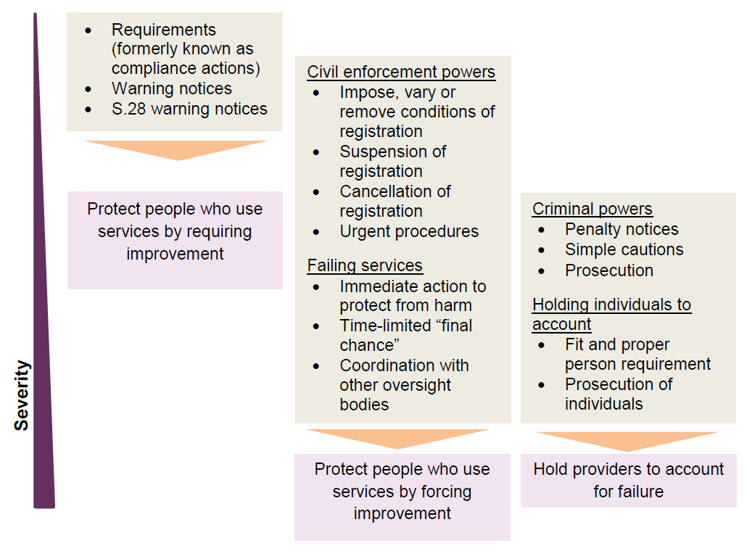
Our enforcement powers
Not an escalator – more than one power can be used
Notes:
Currently conducting a consultation which sets out our proposed guidance for providers to help them meet the requirements of the regs, and our proposed guidance on how we use our enforcement powers (closing date 17 October 2014)
It will lead to the replacement in its entirety, from April 2015 of CQC’s current Guidance about compliance: Essential standards of quality and safety and current enforcement policy.
Our inspections will focus on rating providers on the five key questions for identifying good care, but where we identify poor care this guidance will help us to also determine whether there is a breach of regulations and, if so what action to take.
In October 2014 following our recent consultation we will be publishing our provider handbooks which details how we will set out the details of our new approach. They will describe how we will carry out inspections, make judgements and award ratings to providers

Slide 18
So what else has changed ?
Market oversight responsibilities
Special measures
Display of ratings
Duty of Candour
Fit and proper persons: directors
18

Slide 19
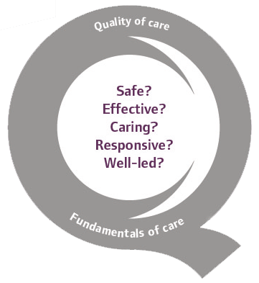
Thank you
www.cqc.org.uk
enquiries@cqc.org.uk
@CareQualityComm
19

