Slide 1
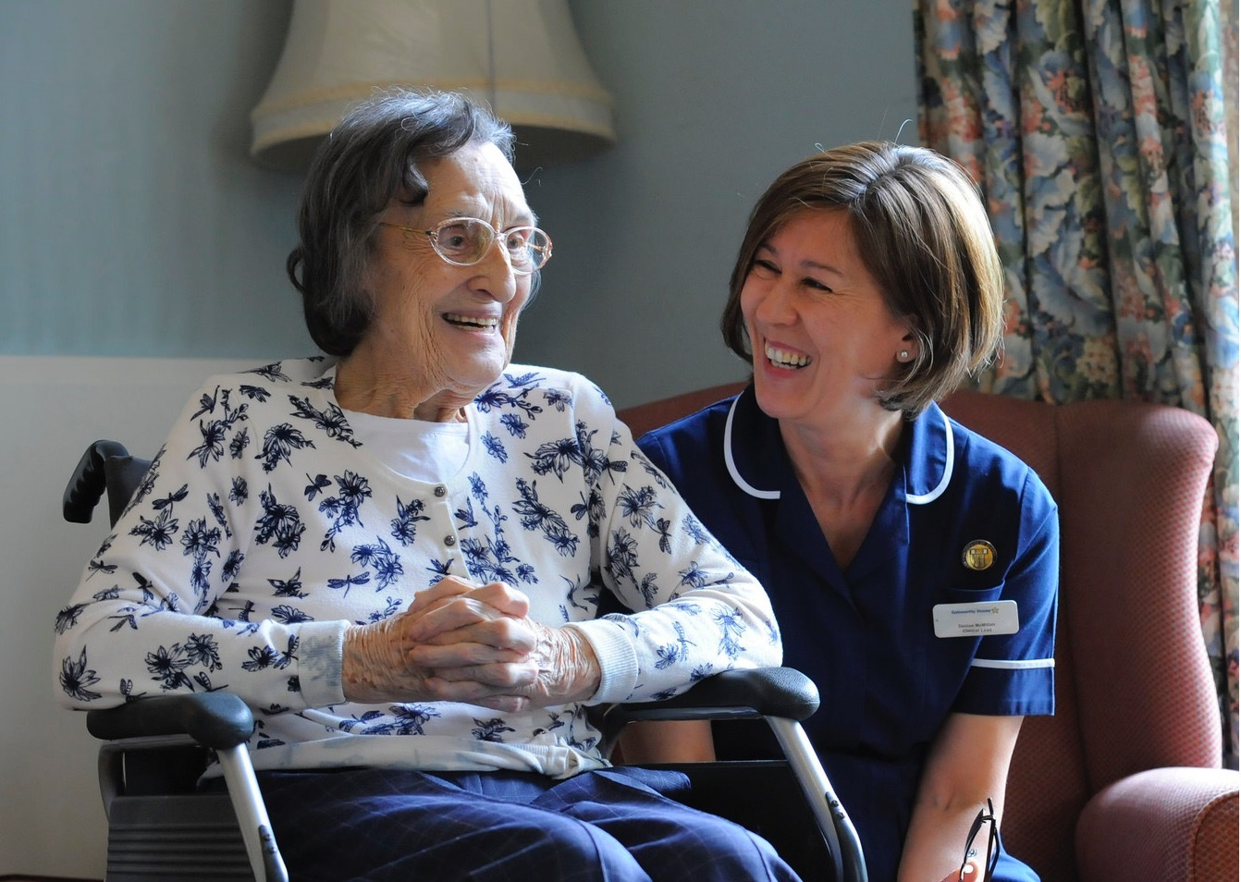
Our new approach: now and for the future
Barbara Skinner
Inspection Manager - Adult Social Care
January 2015
1

Slide 2
Our purpose and role
Our purpose
We make sure health and social care services provide people with safe, effective, compassionate, high-quality care and we encourage care services to improve
Our role
We monitor, inspect and regulate services to make sure they meet fundamental standards of quality and safety and we publish what we find, including performance ratings to help people choose care
2
2

Slide 3
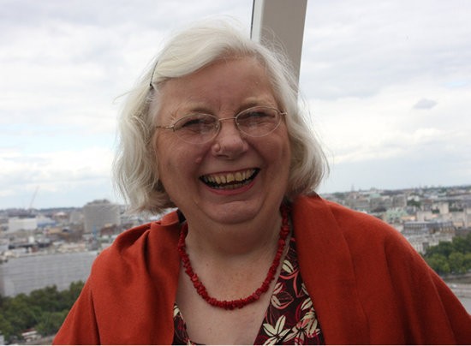
The Mum Test
Is it good enough for my Mum?
Is it responsive to people’s needs?
Is it
effective?
Is it safe?
Is it
well-led?
Is it caring?
3

Slide 4
Delivering on priorities (1)
New ASC directorate
April 2014
Wave inspections
***
ASC co-production groups/ task and finish groups/ roundtable groups
***
Public steering groups/focus groups
***
Provider and public online communities
ASC provider handbook consultations April to June 2014
A New Start
June 2013
Adult Social Care Services signposting document Oct 2013
4

Slide 5
Delivering on priorities (2)
KLOES & Ratings published September 2014
New approach inspections rolled out October 2014
New regulations including Fit and Proper Person and
Duty of Candour
introduced
April 2015
All ASC services rated by March 2016
State of Care
Cracks in the Pathway
First Ratings
October 2014
5

Slide 6
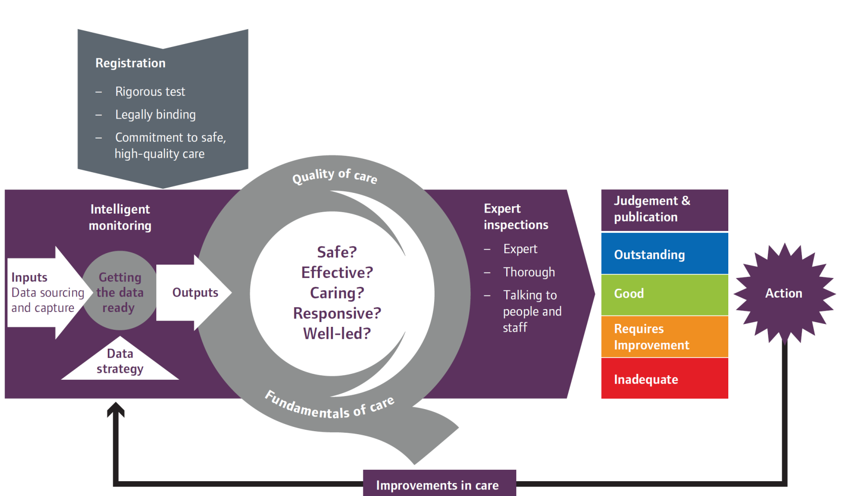
The new approach
6

Slide 7
Four point scale
High level characteristics of each rating level
Innovative, creative, constantly striving to improve, open and transparent
Consistent level of service people have a right to expect, robust arrangements in place for when things do go wrong
May have elements of good practice but inconsistent, potential or actual risk, inconsistent responses when things go wrong
Severe harm has or is likely to occur, shortfalls in practice, ineffective or no action taken to put things right or improve
7
Notes:
Following each inspection, we will judge whether services are outstanding, good, requires improvement or are inadequate.
We have developed characteristics to describe what each of these ratings looks like (which we’ll take a closer look at in our next table session).

Slide 8
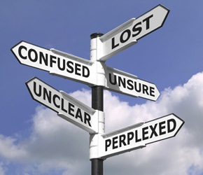
Encouraging improvement
8
Notes:
Spotlight on improvement
Clarity about clear expectations and clear information
Take action
Find information e.g. COT, SCIE, Skills for Care
Celebrate success e.g. National Care Home Open Day

Slide 9
State of Care 2013/14: Variation
Notes:
The report gives our perspective on the state of care in England
It is our first assessment since we’ve introduced our new, more rigorous and expert-led approach to regulation and inspection
It means we’re beginning to build a bigger and deeper understanding of the quality of care
Through this new approach and our new ratings, we have already seen outstanding care, and rated many services as good. We will champion and celebrate good care wherever we find it.
But we have also found services that are inadequate or require improvement.
This variation is quality and safety is too wide. It is unacceptable.

Slide 10
Adult social care
Notes:
We’ve seen many examples of excellent care in adult social care
But also significant variation. Quality in nursing homes is poorer than that that in residential care homes (i.e. without nursing provision)
Adult social care is a tough job, but very rewarding for people with the right values.
Staff need to be supported, value and trained well, and we want to see more nurses encouraged to join the care home sector.
What lies at the heart of safe, caring and compassionate care is good leadership.
Typified by registered managers in care homes - those with a manager in place provided much better care than those without a manager in place for a length of time
Our challenge to providers and the system:
Maintain a focus on recruiting for values and building the professionalism of staff.
Leaders at all levels should develop a culture of support, openness and learning.
Recognise and value excellence in all staff, especially those in professional or leadership positions.
Have the courage to tackle failure in the interests of people who use services.

Slide 11
Dementia report: Cracks in the Pathway
The quality of dementia care is variable – not everyone is meeting the standards we expect
Across more than 90% of care homes and hospitals visited, we found some variable or poor care
Transitions between services should be improved
People are likely to experience poor care at some point

Slide 12
Inspections and ratings
Outstanding
Good
Requires improvement
Inadequate
5
255
105
17
Published
reports on
19 January
2015
12
Notes:
Will we find more poor care? I believe that our new model will reveal more poor care and we will be empowered to change that. There will be a spotlight on both good and poor care and we are clear about our expectations for what that looks like.
The people who use and choose care, will know whether care is Inadequate, Requires improvement, Good or Outstanding - through our new ratings system.
We recognise that providing good care is harder. Everyone’s finances are squeezed, but good care is vital every day for everyone.
We will celebrate good care more.
Good care has the power to transform people’s lives.
Our role is to influence good care by signposting to the good stuff! Our ratings will show the way.
Providers and commissioners must also play their part.

Slide 13
Next steps for CQC
Embedding our methodology
Corporate providers
Market oversight
Different models e.g. supported living
Special measures and enforcement
9
Notes:
We have come such a long way in the last 12 months.
We now need to fit in the last pieces of our corporate jigsaw:
Embed our methodology throughout our teams of inspectors and the providers they inspect.
Improve our relationships with corporate providers and introduce an effective Market Oversight process.
Be more responsive to different models e.g. supported living
Run effective special measures and enforcement processes.

Slide 14
Why market oversight?
Clear relationship between quality of care and finances
Notes:
There is a relationship between the quality of care and the finances. If you see quality dropping that can be an indication of wider problems. Long-overdue need for redecoration, lack of activities, poor food, and over-use of agency staff are all things we may be able to spot on our visits to homes. Our inspectors often know instinctively that they are seeing something that needs to be explored further.

Slide 15
What can Market Oversight do?
Market oversight aims to:
Spot if a ‘Southern Cross’ could happen again
Protect people in vulnerable circumstances
Monitor finances of ‘difficult to replace’ providers
Provide early warning to local authorities
Assist in co-ordinating the system response if failure occurs
Market oversight is not there to:
Protect providers from failure
Pre-empt failure through disclosure of information

Slide 16
Timelines for market oversight
Sept – Dec 2014 | Development of CQC approach and methodology CQC engagement on proposed methods
Jan – Feb 2015 | Identify and liaise with providers that meet the market oversight entry criteria
April 2015 | Formally notify providers of their inclusion in the scheme and respond to appeals Start to undertake financial assessments of providers in the scheme
October 2015 | Bring specialist providers into the scheme
16

Slide 17
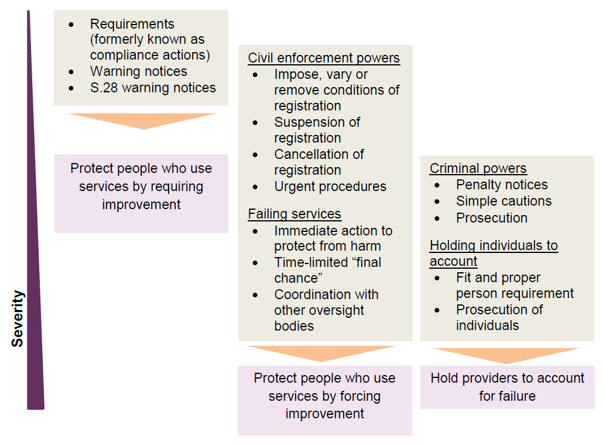
Our enforcement powers
Not an escalator – more than one power can be used
Notes:
Currently conducting a consultation which sets out our proposed guidance for providers to help them meet the requirements of the regs, and our proposed guidance on how we use our enforcement powers (closing date 17 October 2014)
It will lead to the replacement in its entirety, from April 2015 of CQC’s current Guidance about compliance: Essential standards of quality and safety and current enforcement policy.
Our inspections will focus on rating providers on the five key questions for identifying good care, but where we identify poor care this guidance will help us to also determine whether there is a breach of regulations and, if so what action to take.
In October 2014 following our recent consultation we will be publishing our provider handbooks which details how we will set out the details of our new approach. They will describe how we will carry out inspections, make judgements and award ratings to providers

Slide 18
Reflections
Power of the Mum Test
Importance of co-production
9
Notes:
The ‘Mum test’ is real. It is powerful.
In my mind, in my inspectors’ minds, in the minds of the public and the minds of those who lead and provide care - we must think: Is this care good enough for my mum? Or any loved one?
If not, we must act.
Very little about the CQC is what you would recognise from the past.
We have three new Chief Inspectors - for hospitals, primary care and adult social care.
We have a new strategy.
We have new methodologies, which reflect the specialisms of care in your own home, dentistry, hospices, acute mental health services, care homes and so on.
We have a new fees structure.
We are introducing ratings.
We are building confidence.
Co-production has shaped all of our work.
We co-produced the changes by working closely with our partners, providers, key stakeholders, the public and people who use services.
Co-production has given a voice to those who commission, provide and use services - shaping a much better end result.

Slide 19
Why does this matter?
People are at the heart of it
19

Slide 20
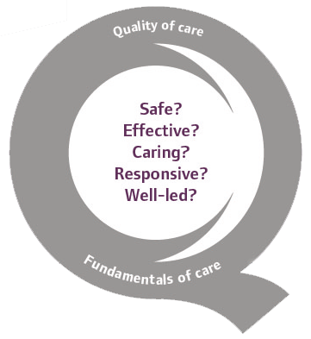
Thank you
www.cqc.org.uk
enquiries@cqc.org.uk
@CareQualityComm
Barbara Skinner
Inspection Manager - Adult Social Care
20

